Slide 1
Python Tkinter Based Advanced calculator
Objectives
Perform basic scientific finance and time calculations.
Provide a simple and user-friendly interface.
GUIDANCE: NEXTHIKES IT SOLUTIONS
Presented BY : MANSHI AHUJA

Slide 2
MAIN FEATURES OF CALCULATOR
Basic & Scientific Calculator
Basic Calculations
Addition, subtraction, multiplication and division
Percentage
Square and square root
Power and π
Brackets
Scientific Calculations
sin, cos, tan
log and ln
Factorial
Reciprocal
Powers
Finance & Time Converter
Finance Calculator
Simple Interest
Compound Interest
EMI Calculator
User input for principal, rate, time and loan details
Time Converter
Minutes → Seconds
Hours → Seconds
Minutes & Seconds → Total Seconds
Additional Features & Working
Additional Features
MC, MR, M+, M-
Ans button
Calculation History
Copy Result
Keyboard Support
Dark / Light Theme
Working User Input → Processing → Calculation → Result → History

Slide 3
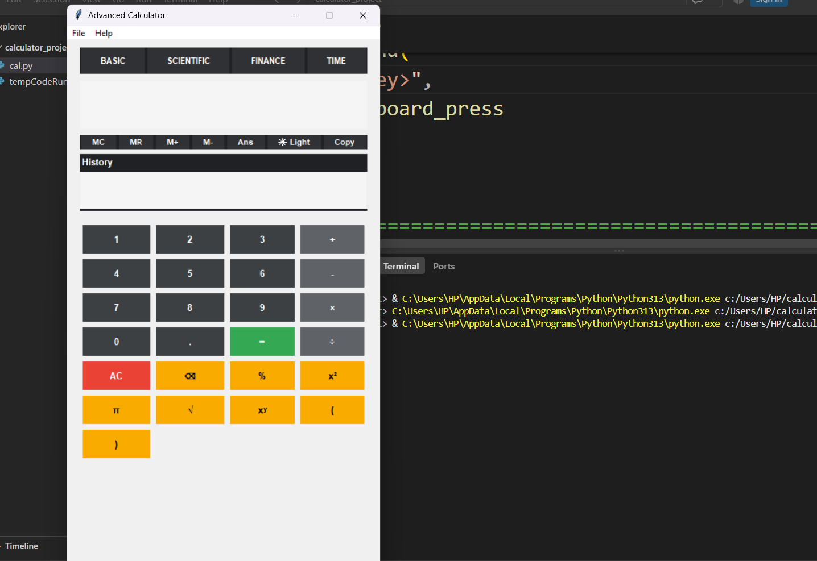
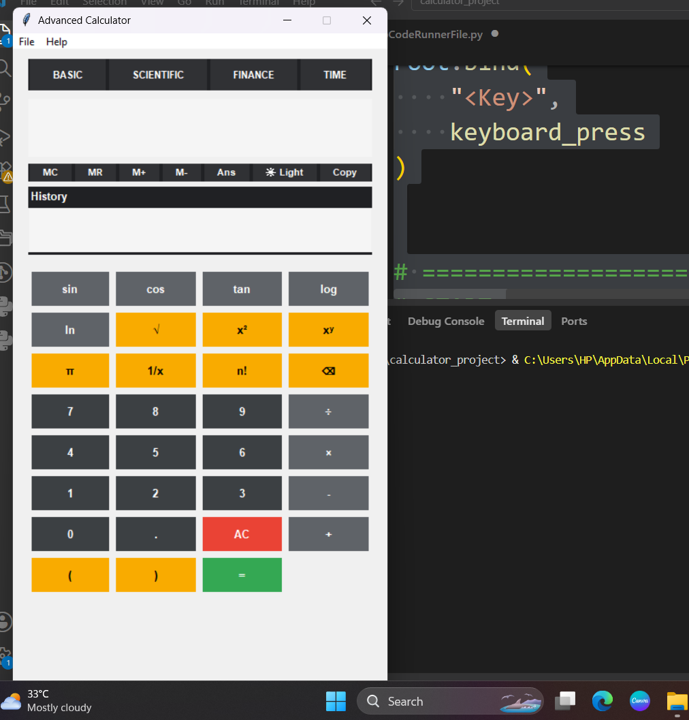
BASIC INTERFACE
SCIENTIFIC INTERFACE

Slide 4
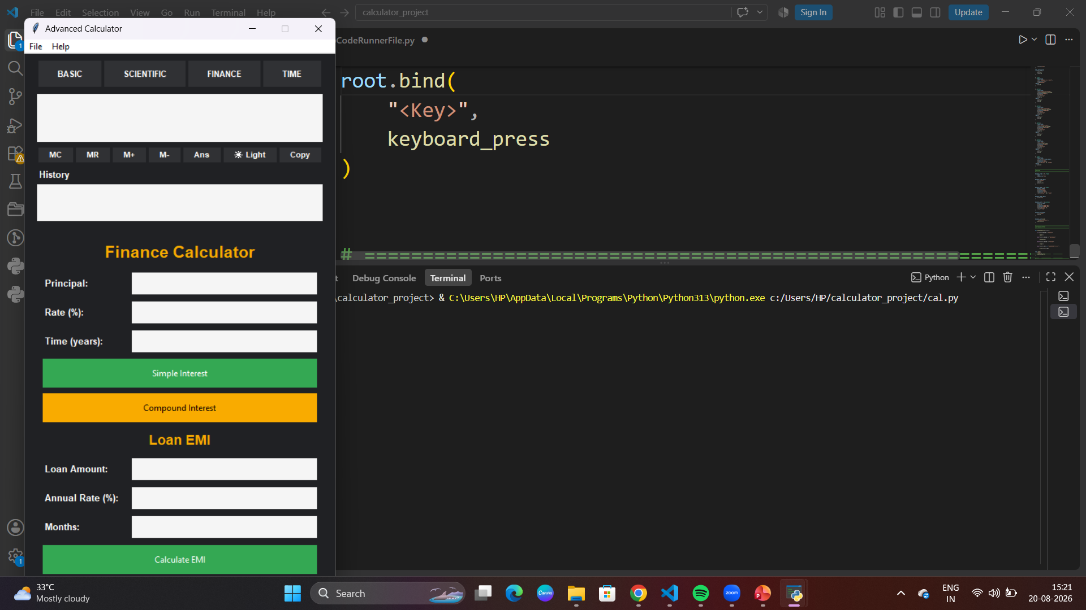
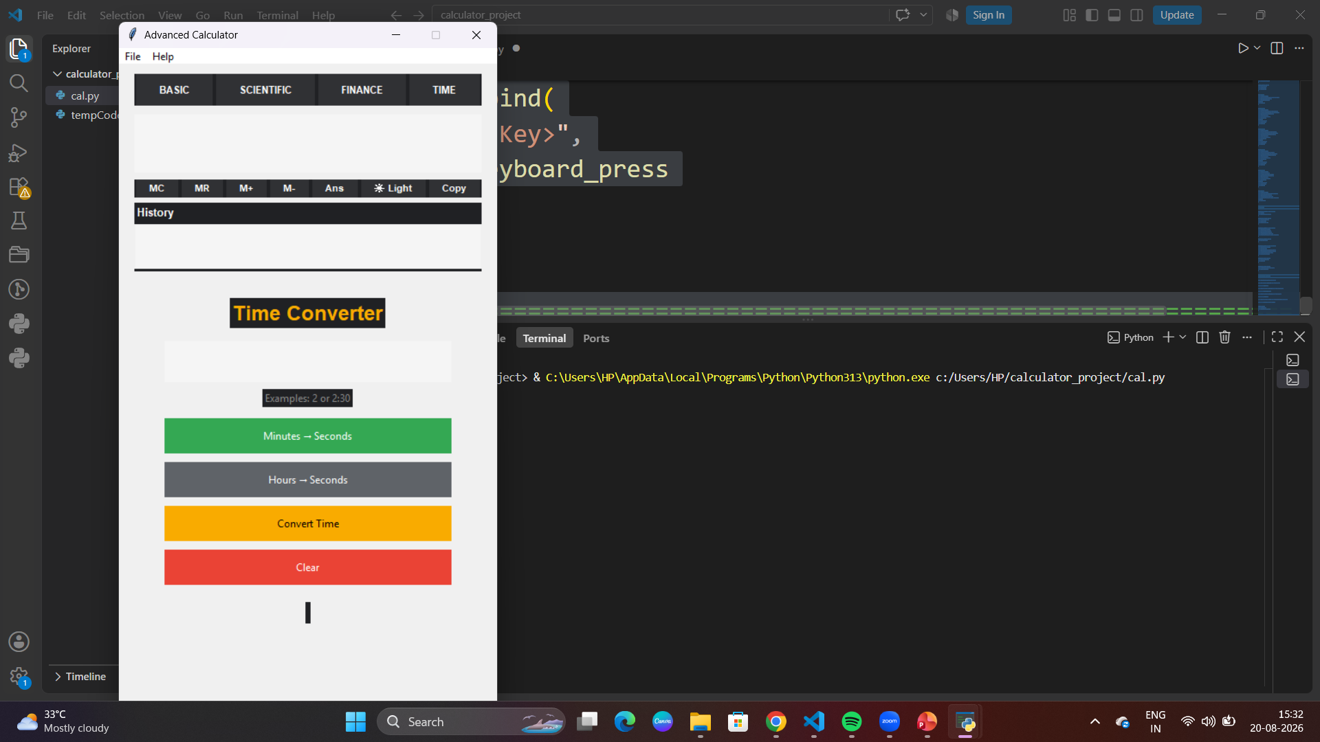
FINANCE INTERFACE
TIME INTERFACE

Slide 5
Conclusion & Future Scope
Successfully developed an Advanced Calculator using Python and Tkinter.
Provides Basic, Scientific, Finance and Time calculation features.
Includes Memory, History, Keyboard Support and Theme options.
Simple and user-friendly GUI makes calculations easy and efficient.
Future Scope
Currency Converter
Unit Converter
Graph Calculator
More Scientific Functions
Improved UI and Customization
Thank You!

